Slide 1
10 minutes presentation
Malaysia
(SEAMEO RECSAM)
What is the issue on energy?
What reform is going on?
Lesson study for cross border?
SUHAIDAH TAHIR

Slide 2
What is the issue on energy?
In relation to STEM Education, what reform is going on?
Lesson study for cross border?

Slide 3
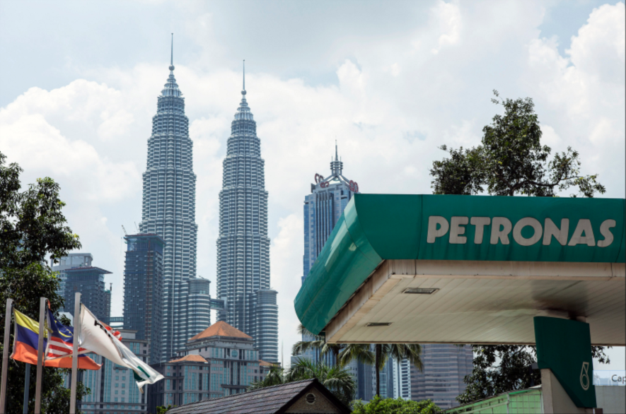
A Petroliam Nasional Bhd. (Petronas) gas station stands in front of the Petronas Twin Towers, second right, in Kuala Lumpur.
Malaysia is the second-largest oil and natural gas producer in Southeast Asia and the world’s second-biggest exporter of liquefied natural gas, according to the U.S. Energy Information Administration. Photographer: Charles Pertwee/Bloomberg

Slide 4
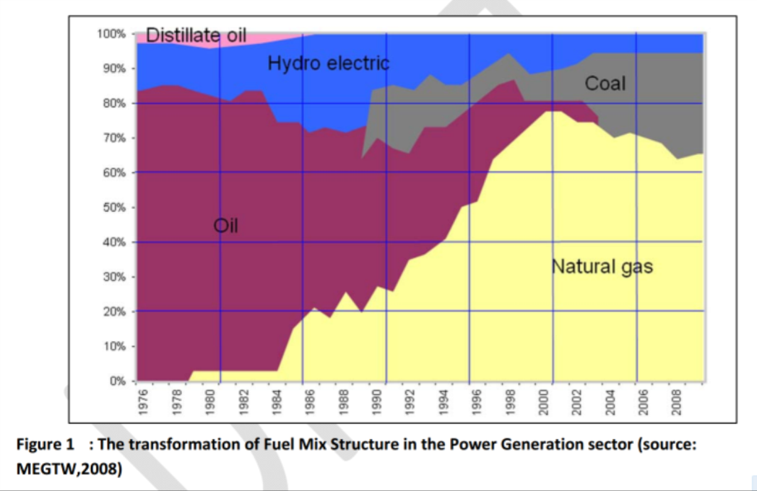

Slide 6
Energy Supply and Demand
Note: i) Primary Energy Supply does not include Renewable Energy (RE) except Hydropower
Source: i) Department of Statistics Malaysia
ii) National Energy Balance 2011

Slide 7
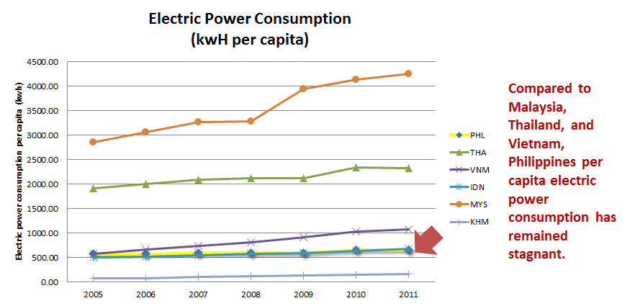

Slide 8
Energy Efficiency In Malaysia’s Key Energy Policies
Petroleum
Development
Act 1974
National
Petroleum
Policy 1975
National
Energy
Policy 1979
National
Depletion
Policy 1980
Four-Fuel
Diversification
Strategy 1981
Five-Fuel
Diversification
Strategy 2001
Vested on PETRONAS the exclusive rights to explore, develop and produce petroleum resources of Malaysia
To regulate downstream oil & gas industry via the Petroleum Regulations 1974
To ensure adequacy, security and cost-effectiveness of energy supply
To promote efficient utilization of energy
To minimize negative environmental impacts in the energy supply chain
To prolong lifespan of Malaysia’s oil reserves for future security & stability of oil supply
To pursue balanced utilization of oil, gas, hydro and coal
Renewable Energy included as the “fifth fuel” in energy supply mix

Slide 9
Energy Efficiency Initiatives In Malaysia
Energy efficiency promotion in the Seventh Malaysia Plan (1996-2000)
Malaysian Industrial Efficiency Improvement Programme (MIEEP) (1999)
Fiscal incentives for EE (2001)
Development of Malaysian Standard MS 1525 (2001)
Capacity building on EE and DSM for key institutions (2002)
Energy audit on government buildings (2002)
EE and RE in education curriculum and university courses (2002)
Energy efficient building demonstration projects (2004)
Development of EE guidelines for Malaysian industries (2006)
    Efficient Management Of Electrical Energy Regulations (2008)
    Green Building Index (GBI) (2009)
    EE rating and labelling (2009)
    Green Technology Financing Scheme (2010)
    EE equipment rebate scheme (2011)
    Minimum energy performance standards (MEPS) regulations (2013)
    Incentive-based tariff regulation (2014)
    5% energy reduction target for government buildings (2014)

Slide 10
Malaysia’s Final Energy Intensity
Note: Intensity = Quantity of energy required per unit output or activity
(*): Final Energy Demand / GDP at 2005 prices
(**): Industrial Energy Demand / Industrial GDP at 2005 prices
Source: i) Department of Statistics Malaysia
ii) National Energy Balance 2011

Slide 11
Malaysia’s Electricity Intensity
Note: Intensity = Quantity of energy required per unit output or activity
(*): Electricity Intensity (toe/RM Million GDP at 2005 prices
(**): Electricity Intensity (GWh/RM Million GDP) at 2005 prices
Sources: i) Department of Statistics Malaysia
ii) TNB, SESB, SEB and IPPs
iii) National Energy Balance 2011

Slide 12
Heavily subsidised gas price does not make EE attractive
Diesel data available from 2005 onward – source: Department of Statistics

Slide 13
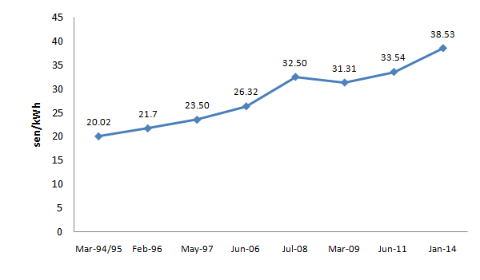
Gradual move towards market pricing of gas and electricity
Peninsular Malaysia’s electricity tariff over the years

Slide 14
Electricity Tariff Comparison
14

Slide 15
To continue enhancing supply-side EE initiatives
Implementing new generation capacity bidding mechanism
Promoting co-generation
Gradual phasing-out of fuel subsidies with selective subsidization
Implementing incentive-based electricity tariff regulation
Minimizing technical and non-technical losses in the supply chain
Enhancing governance in grid system operations through ring-fencing mechanism

Slide 16
What is the issue on energy?
In relation to STEM Education, what reform is going on?
Lesson study for cross border?

Slide 17
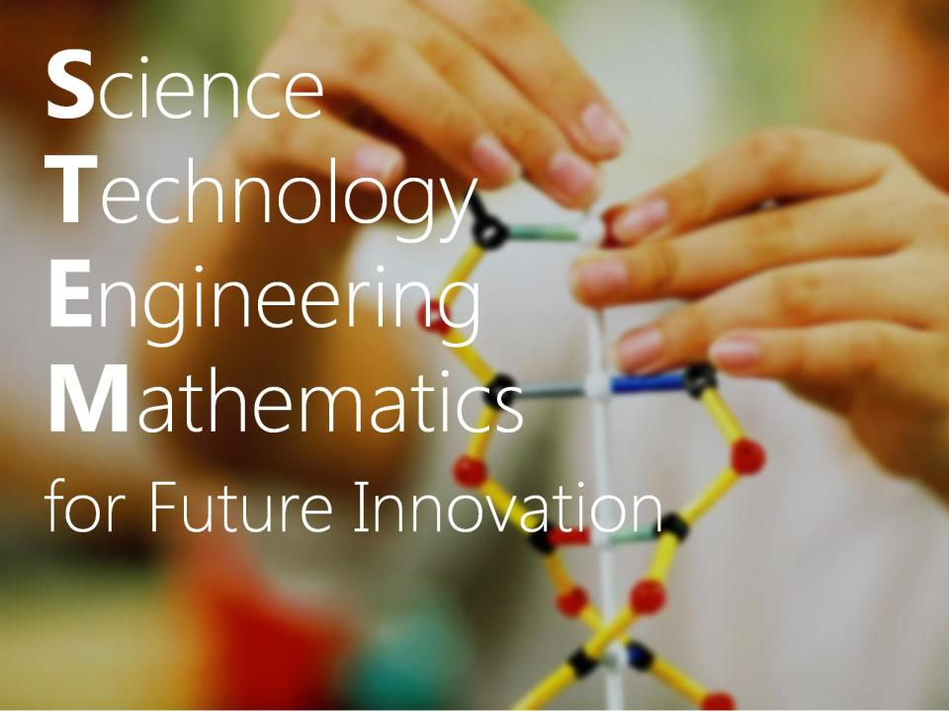

Slide 18
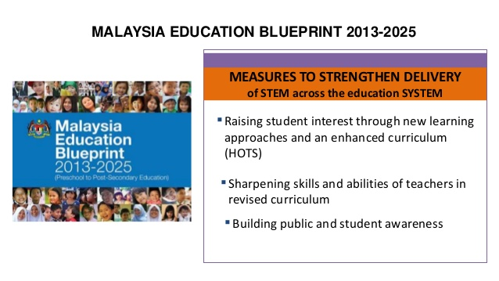

Slide 19
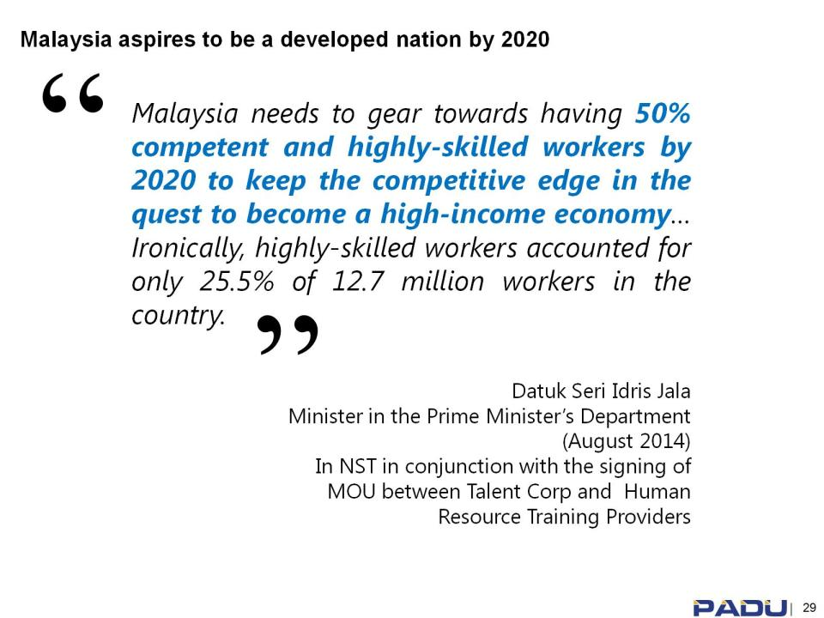

Slide 20
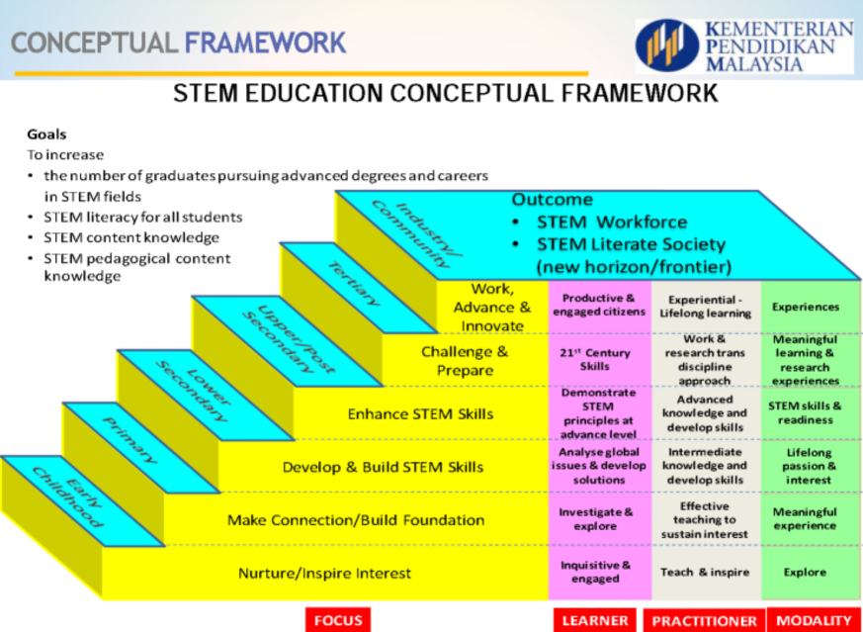

Slide 21
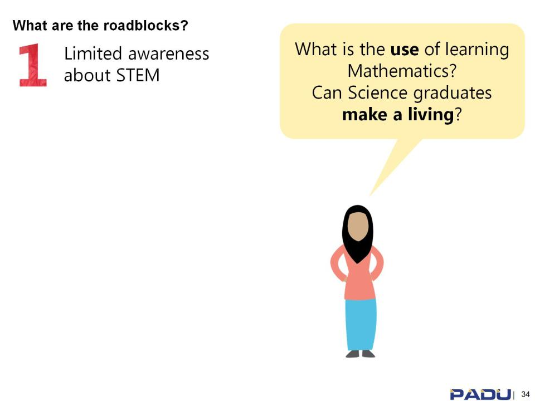

Slide 22
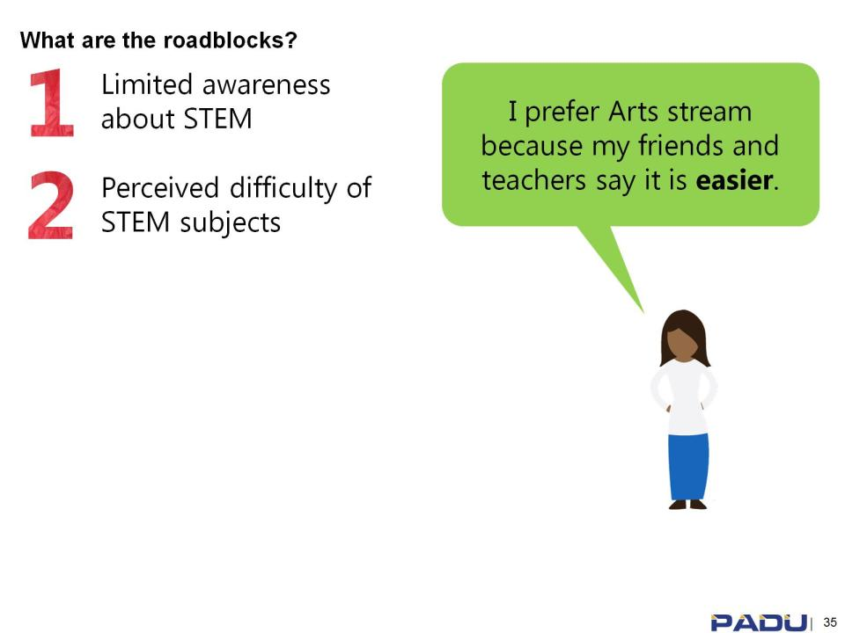

Slide 23
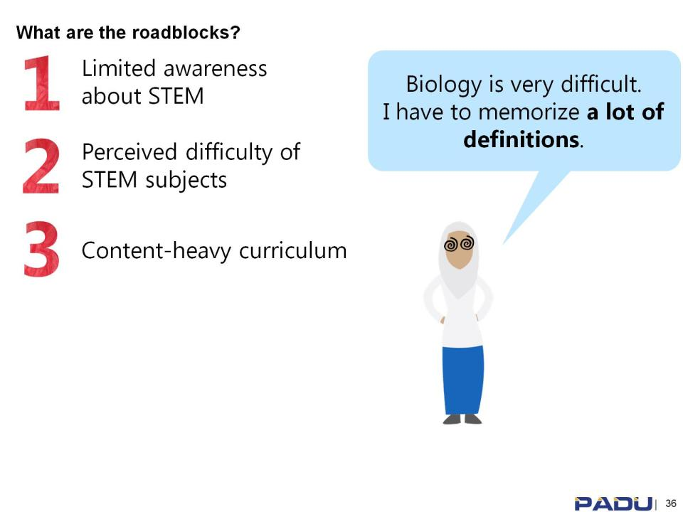

Slide 24
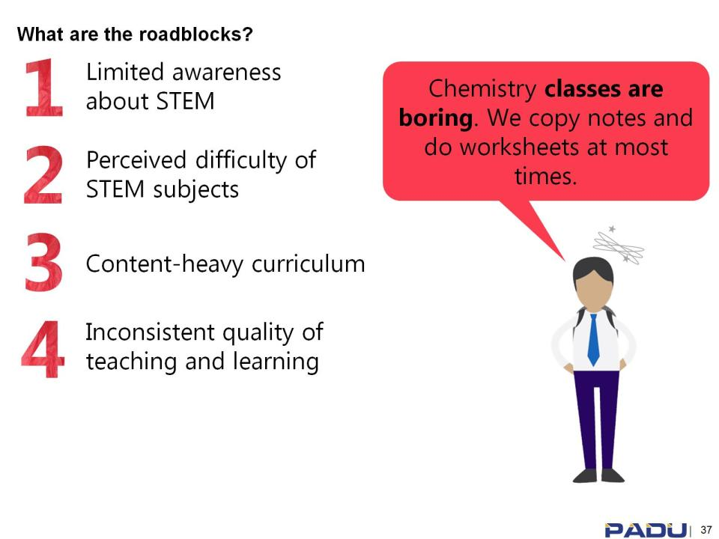

Slide 25
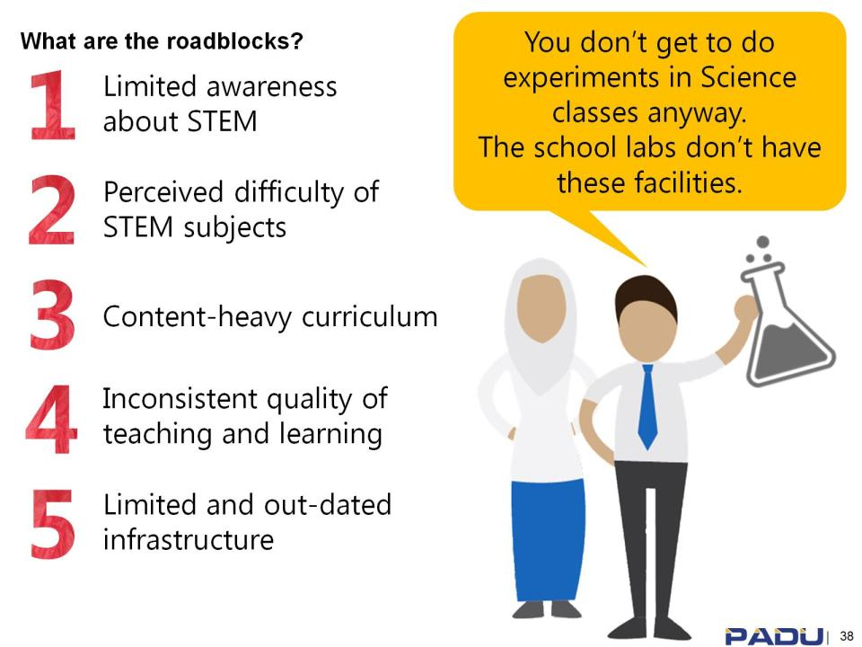

Slide 26
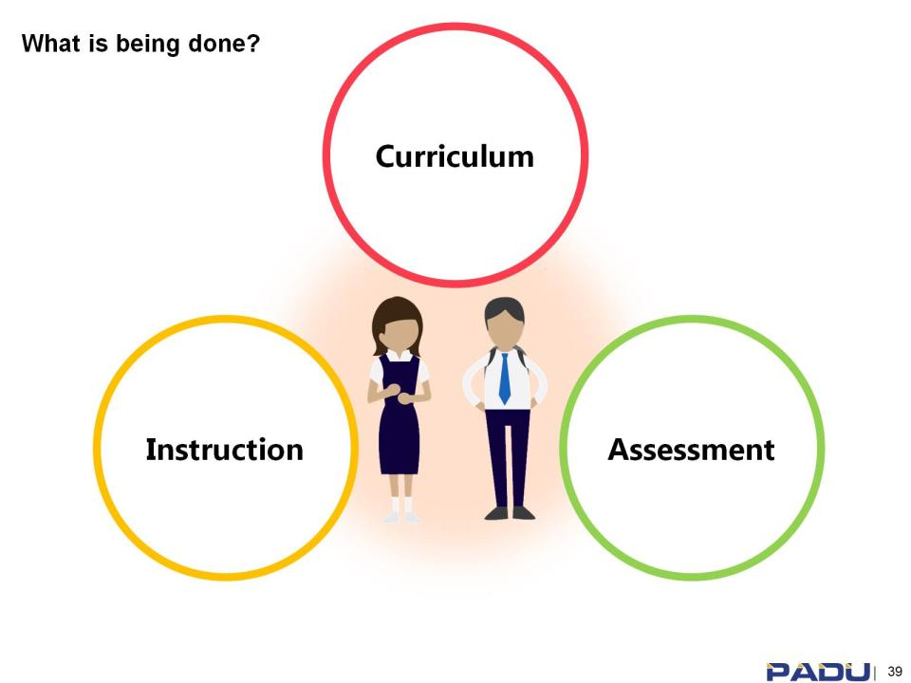

Slide 27


RETURN OF INVESTMENT
STEM teaching & learning in the Classroom:
Higher order thinking skills − Improvements in PISA & TIMSS results
Based on project-focused tasks
Relate to authentic or real world problems
Integrate technology
Reach disciplines both within & beyond STEM fields

Slide 28
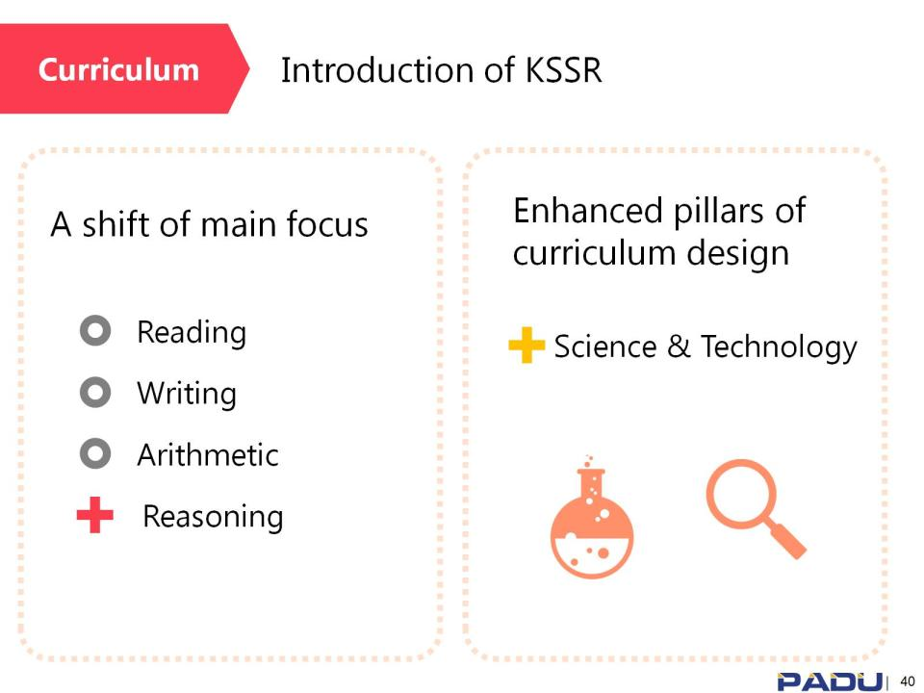
NEW Curriculum standard

Slide 29
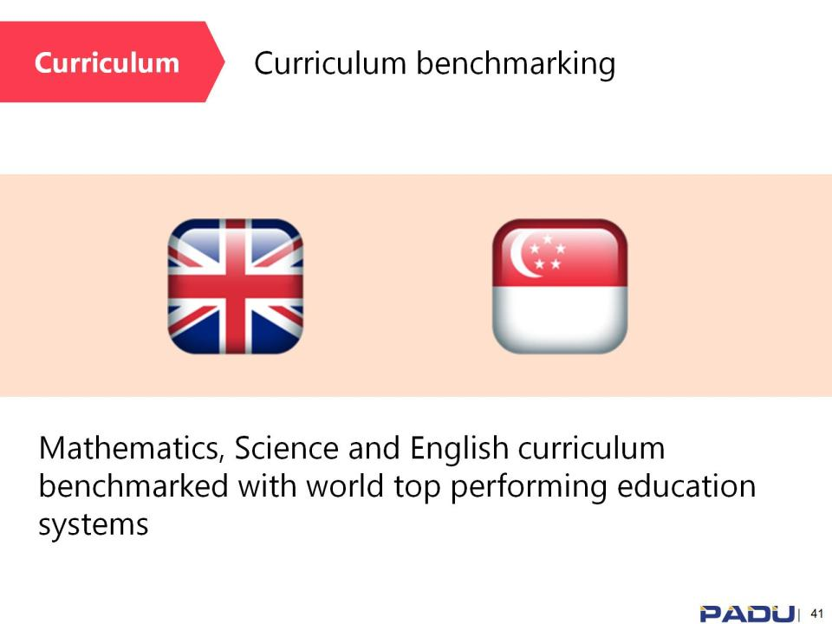

Slide 30
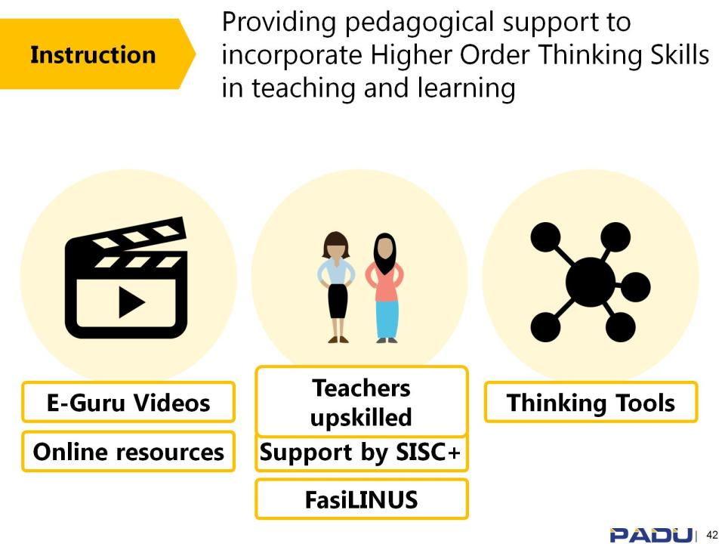

Slide 31
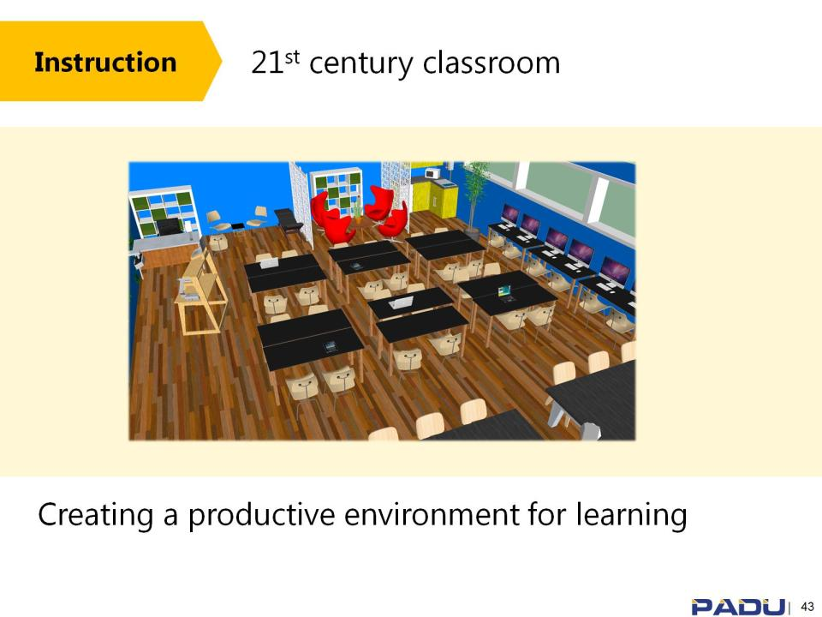

Slide 32
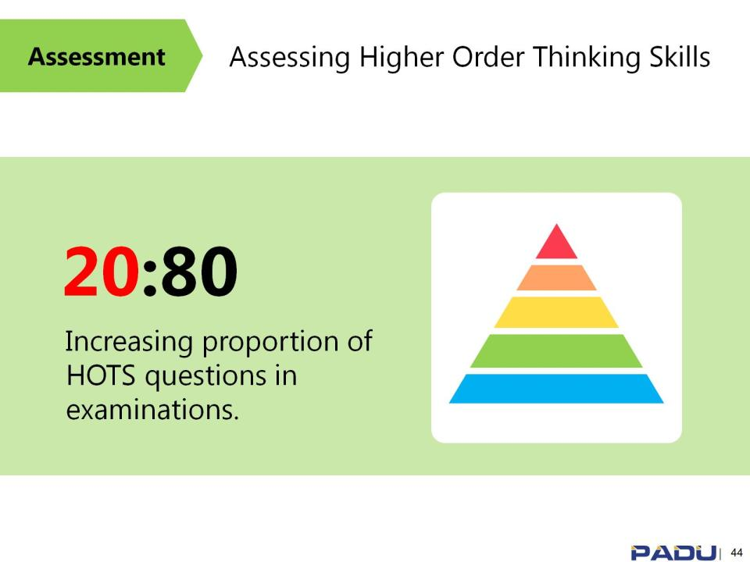

Slide 33
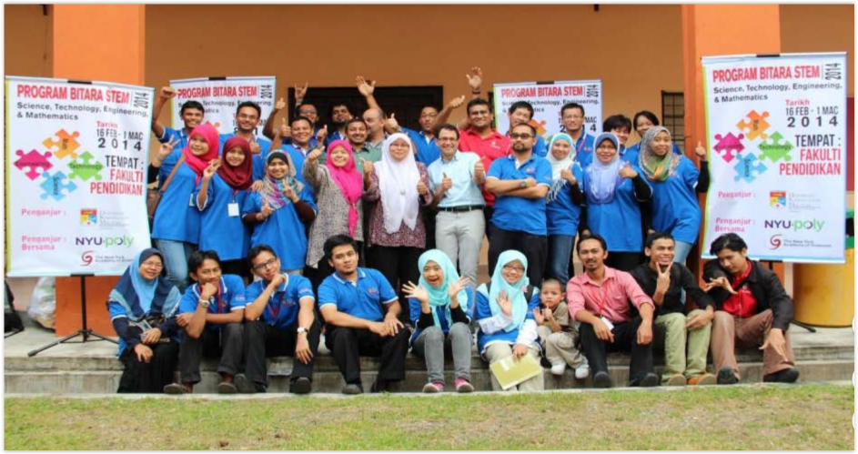
STEM CAMPS

Slide 34
Malaysian International Young Investor Olympiad

Slide 35
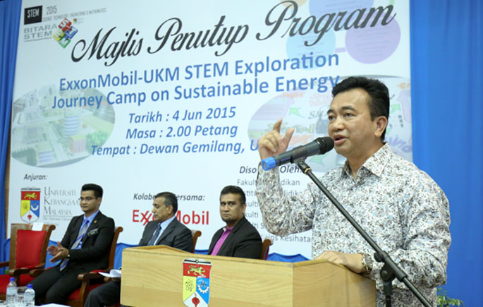

Slide 36
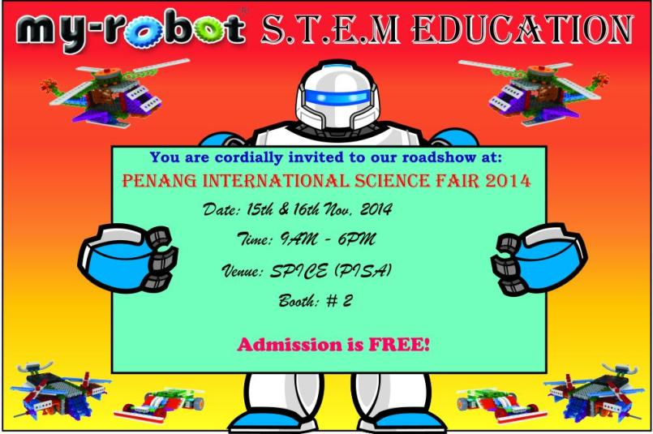

Slide 37
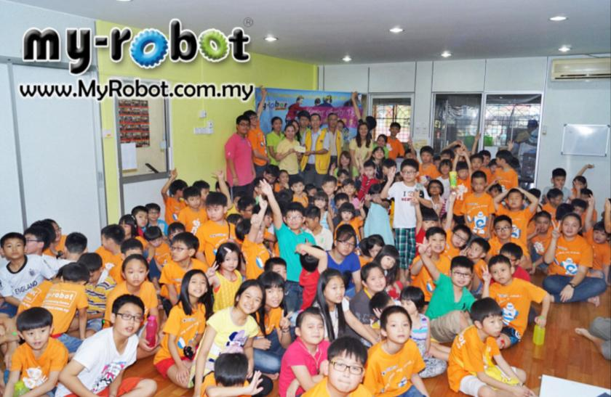

Slide 38
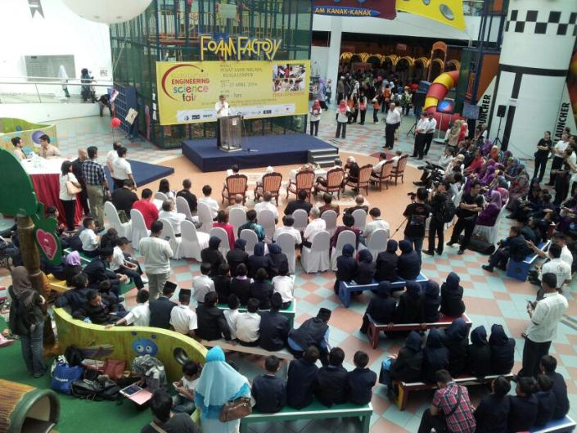
The main objective of KLESF is to stimulate students' interest in Science, Technology, Engineering and Mathematic (STEM) and encourage them to pursue future ..

Slide 39
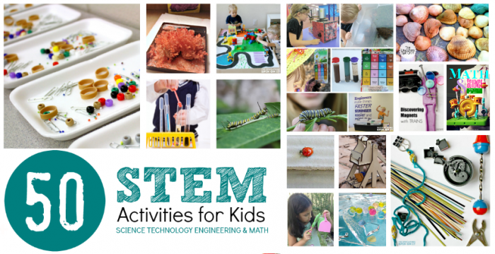

Slide 40
Search for SEAMEO Young Scientists (SSYS) Regional Congress
Year | Theme
1997 | Conserving the Environment Through Youth Science Research
1999 | Technology for Us
2002 | Creating Intelligent Cities for the Harmonious Societies of the New Millennium
2004 | Towards a Sustainable Future
2006 | Sustainable Development for a Better World
2008 | Sustainable Community Development Through Science and Mathematics
2010 | Sustainable Solutions for the Local Community
2012 | Beyond 2012: Greening the Environment for a Sustainable Future
2014 | Disaster Risk Reduction for Sustainable Development
Search for SEAMEO Young Scientists Congress

Slide 41

Next theme: .... 2018 Congress .....”Energy efficiency”....
Need to prepare from now....

Slide 42
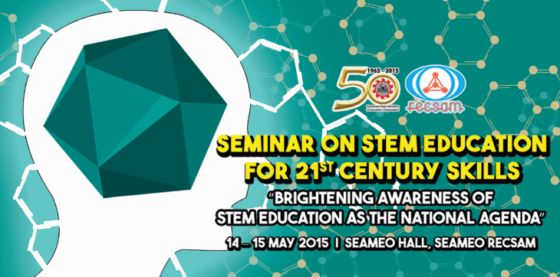
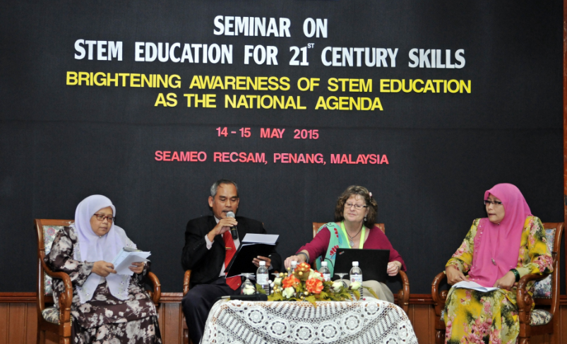

Slide 43
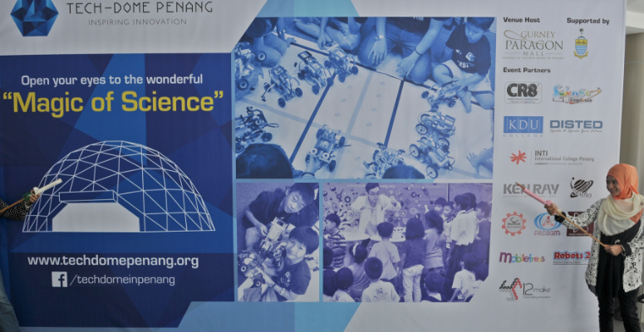

Slide 44
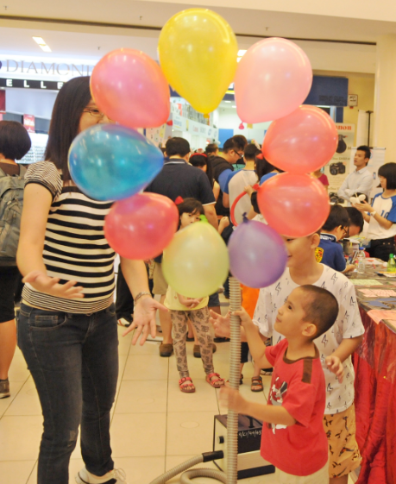
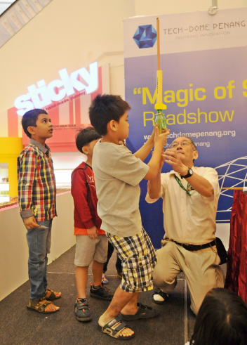

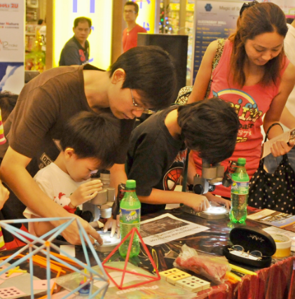
‘MAGIC OF SCIENCE’ ROADSHOW
TECH-DOME PENANG inspiring innovation
RECSAM involvement

Slide 45
What is the issue on energy?
In relation to STEM Education, what reform is going on?
In relation to Lesson study for cross border?

Slide 46
SEAMEO Borderless School Project
Through 50X3 school networking project
  Sharing of resources among SEAMEO Schools
  Module on energy efficiency
  etc

Slide 47
SEAMEO RECSAM is a regional center that enhances competencies of science and mathematics teachers in the Southeast Asian region.
RECSAM plays a significant role in promoting STEM Education through research and training of teachers and educators from SEAMEO member countries.

Slide 48
Regular course April 2016
Meaningful Primary Mathematics Learning in the STEM Environment
Sub-Topic on Energy Efficiency: Awareness of Issues in SEAMEO Countries on Energy Efficiency

Slide 49


